Slide 1


Session 1: Introduction To Python
Middlesex Computing Society: Python Programming
Arfa Kazi, Head of Python Programming

Slide 2
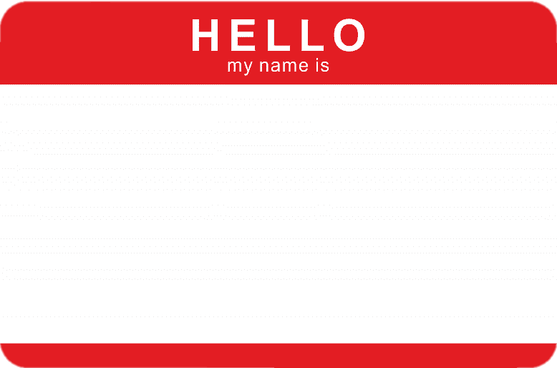
Introduce yourself! :D
Before we begin…

Slide 3
Python Study Group Structure
Introduction to Python
Data Types and operators
Conditionals and Loops
Functions and Modules
Object Oriented Programming
Libraries and Introduction to Capstone Project

Slide 4

This Week’s objectives:
Understand what Python is and its applications
Set up the Python environment
Learn basic syntax and Input/Output Operations
Write and run your first Python program!!

Slide 5


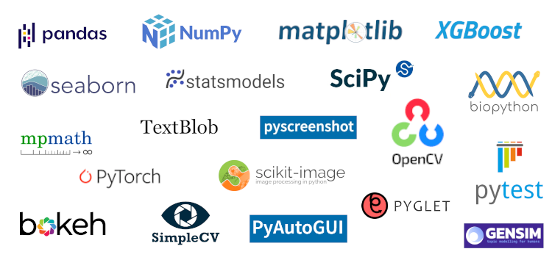
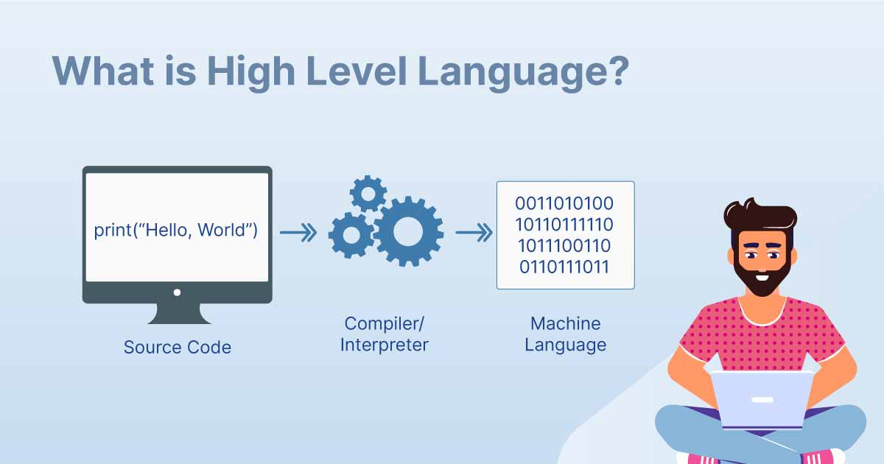
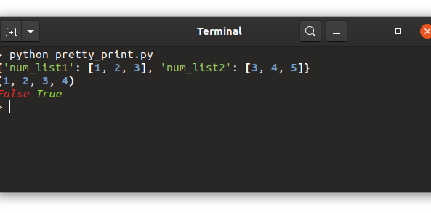
What is Python?
Python is a high-level, interpreted programming language known for its simplicity and readability. It was created by Guido van Rossum and first released in 1991.
Key Features:
Interpreted: Python code is executed line by line, which makes debugging easier.
High-level: Python abstracts complex details, making it easier to focus on the logic of the program.
Dynamic typing: Variables in Python are not explicitly declared, and their type is determined at runtime.
Large standard library: Python comes with a vast collection of modules and packages, which reduce the need for writing code from scratch.

Slide 6
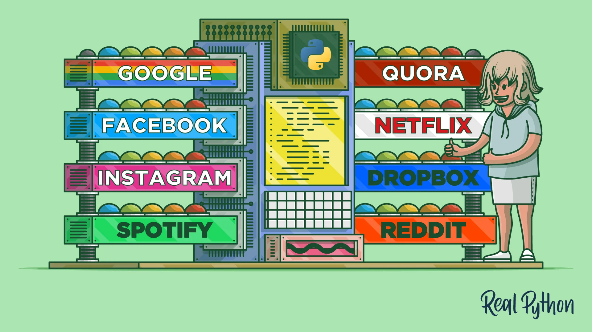
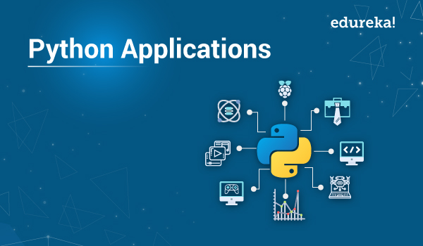
Why Python is Good for You?
Ease of Learning: Clear syntax, great for beginners.
Versatility: Used across various domains and industries, not just tech.
Finance: Automating trading strategies and risk management.
Healthcare: Analyzing medical data.
Education: Developing educational software and tools.
Retail: Inventory management and sales data analysis.
Job Market and Career Opportunities: High demand for Python skills.
Strong Community and Support: Large, active community with abundant resources like tutorials, documentation, and forums.

Slide 7
How to install Python?
Minimum Software Requirements:
OS: Windows 7+, macOS 10.9+, Linux
Hardware: 1 GHz CPU, 512 MB RAM, 100 MB Disk Space
Steps:
Download Python:
Visit python.org/downloads. Click "Download Python.“
Run the Installer:
Windows: Check "Add Python to PATH," click "Install Now.“
macOS: Open .pkg file, follow prompts.
Verify Installation:
Open terminal/command prompt. Type python --version or python3 --version.
Install an IDE:
VS Code: Download from Visual Studio Code site, install Python extension.

Slide 8
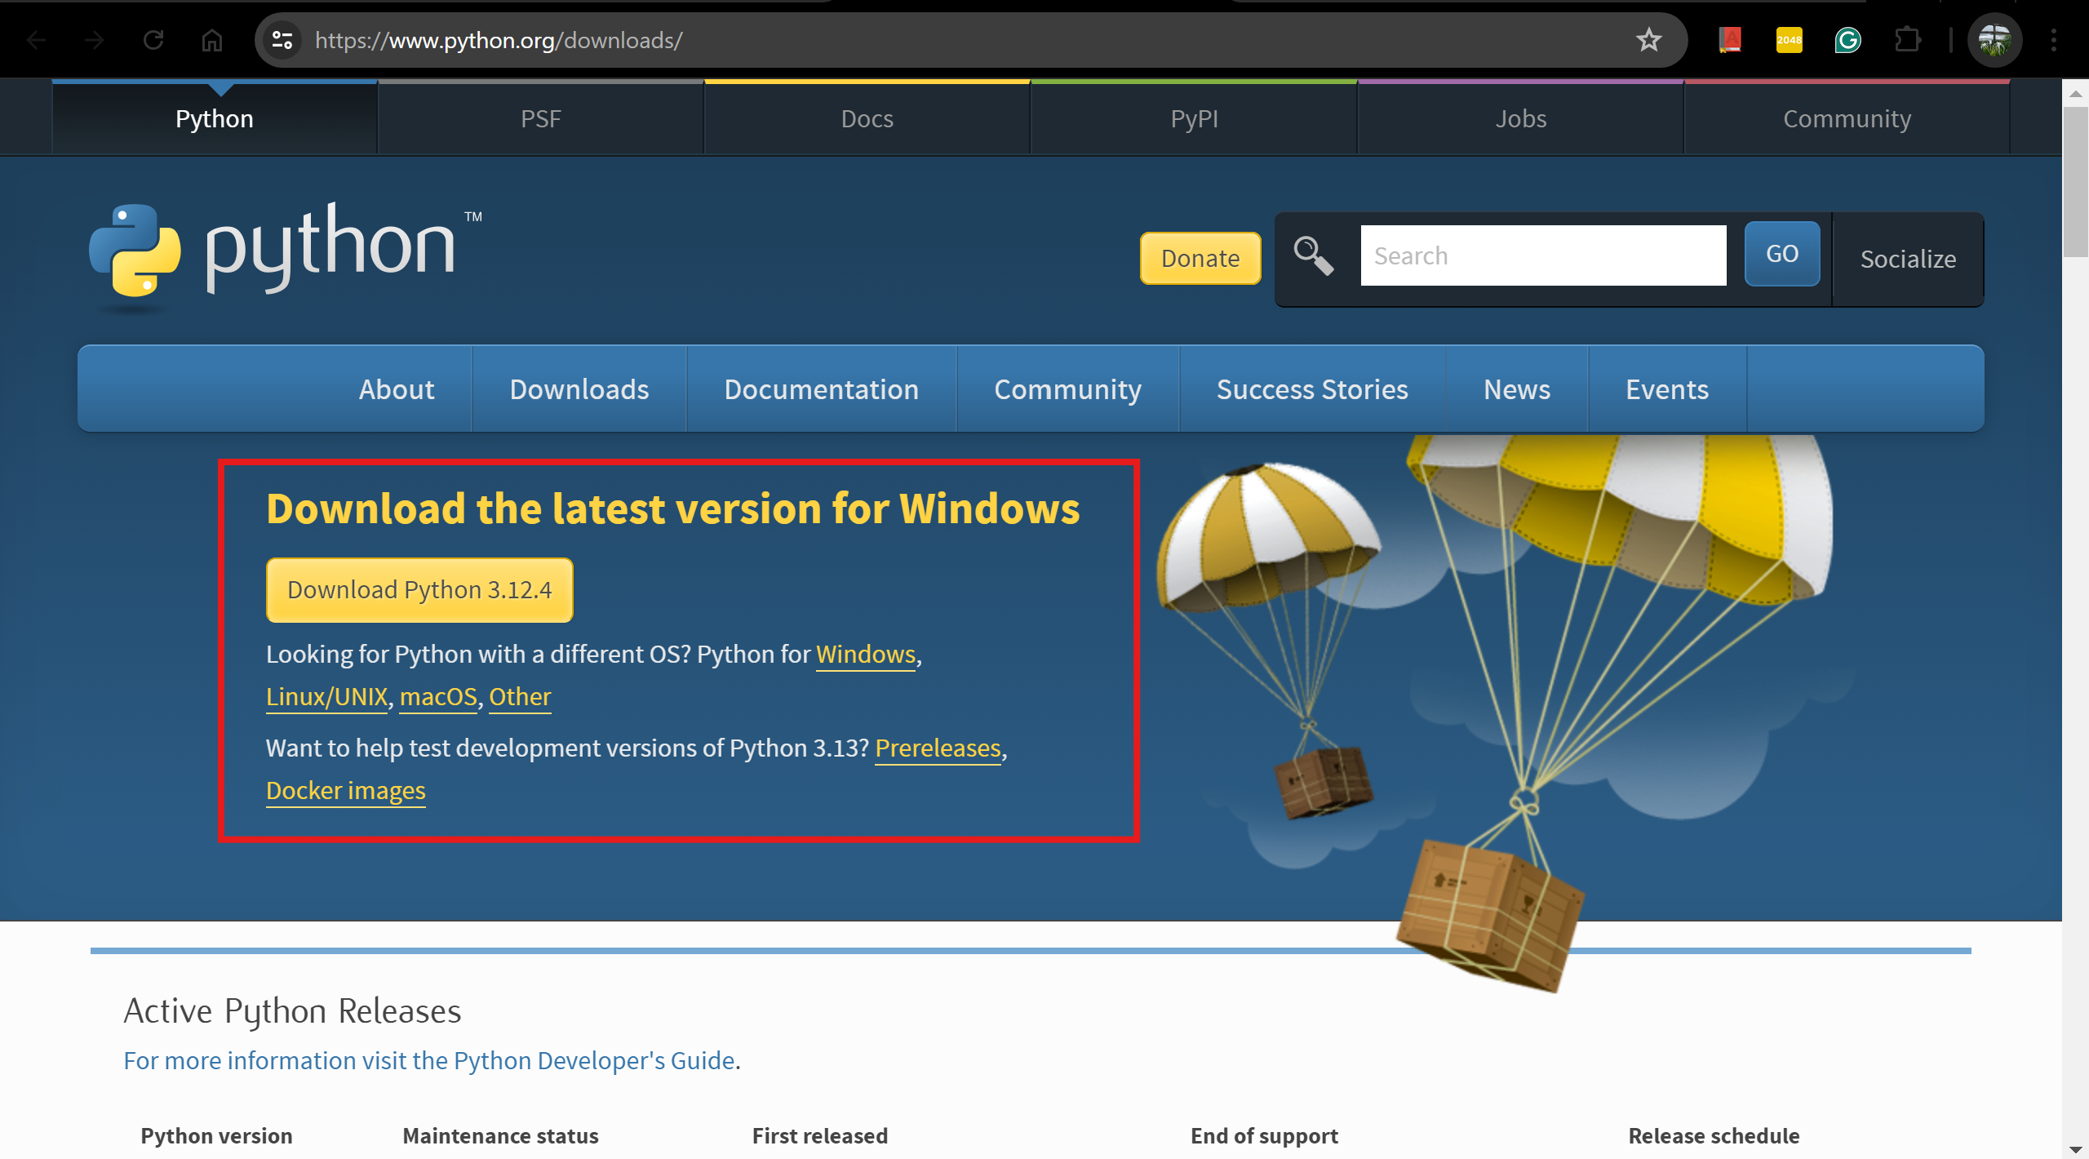

Slide 9
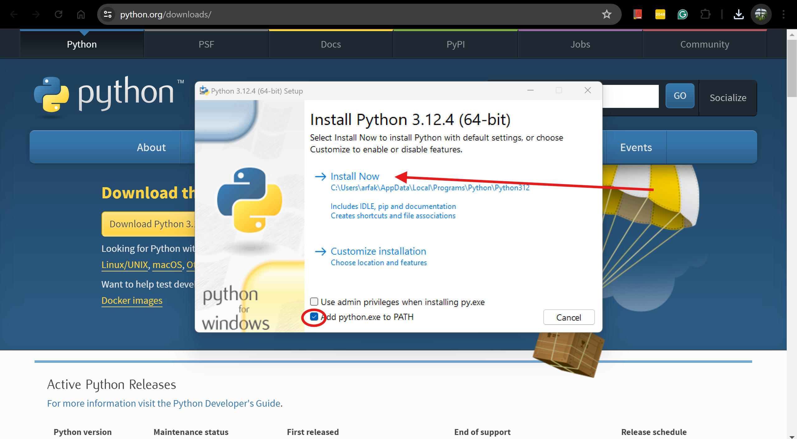

Slide 10
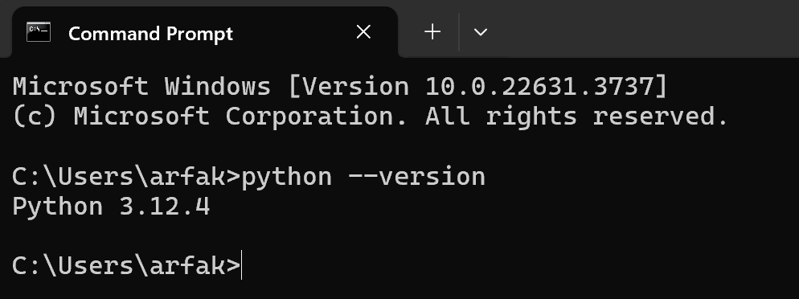
Terminal/Command Prompt

Slide 11
IDE (Integrated Development Environment)
What is an IDE?
A software application that provides tools to write and test code. Think of it as your coding home base. It helps you write, test, and debug your code all in one place.
Why Use an IDE?
Keeps Things Organized: All your files and code in one spot.
Error Spotter: Highlights mistakes so you can fix them quickly.
Time Saver: Handy tools that make coding faster and easier.
I’ll be using Thonny to demonstrate! Feel Free to use any IDE of your choice!!

Slide 12
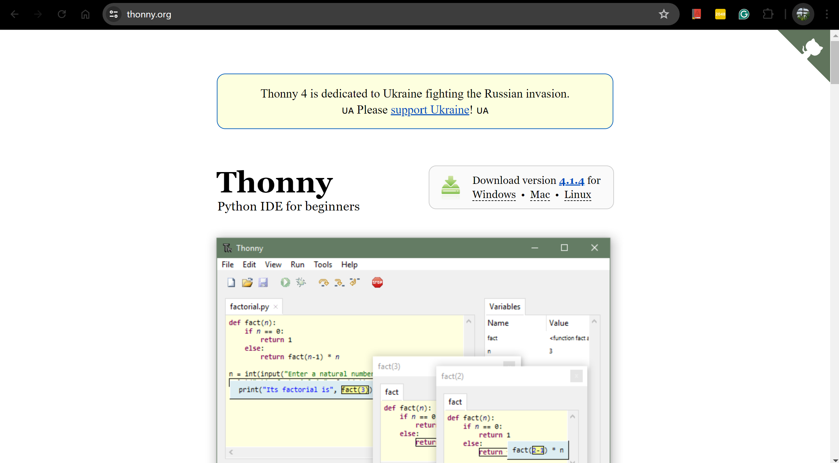

Slide 13
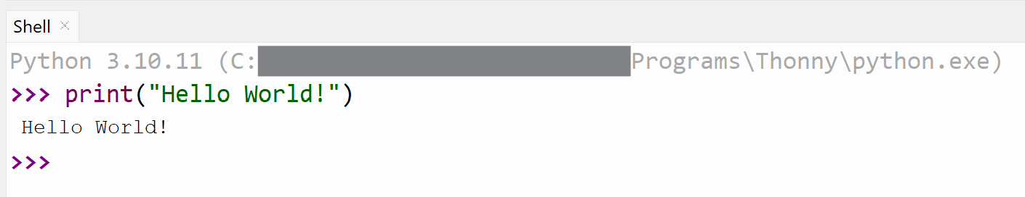
Your first Python Program!
Type print(“Hello World!”) in the shell/terminal.
Hit Enter and you can see the output of your first run.
Now Let’s write a Multi-Line Script.
Save the script in a folder and name it FirstProgram.py
Type:
print(“Hi, My Name is [Your Name]”)
print(“Nice to meet you”)

Slide 14
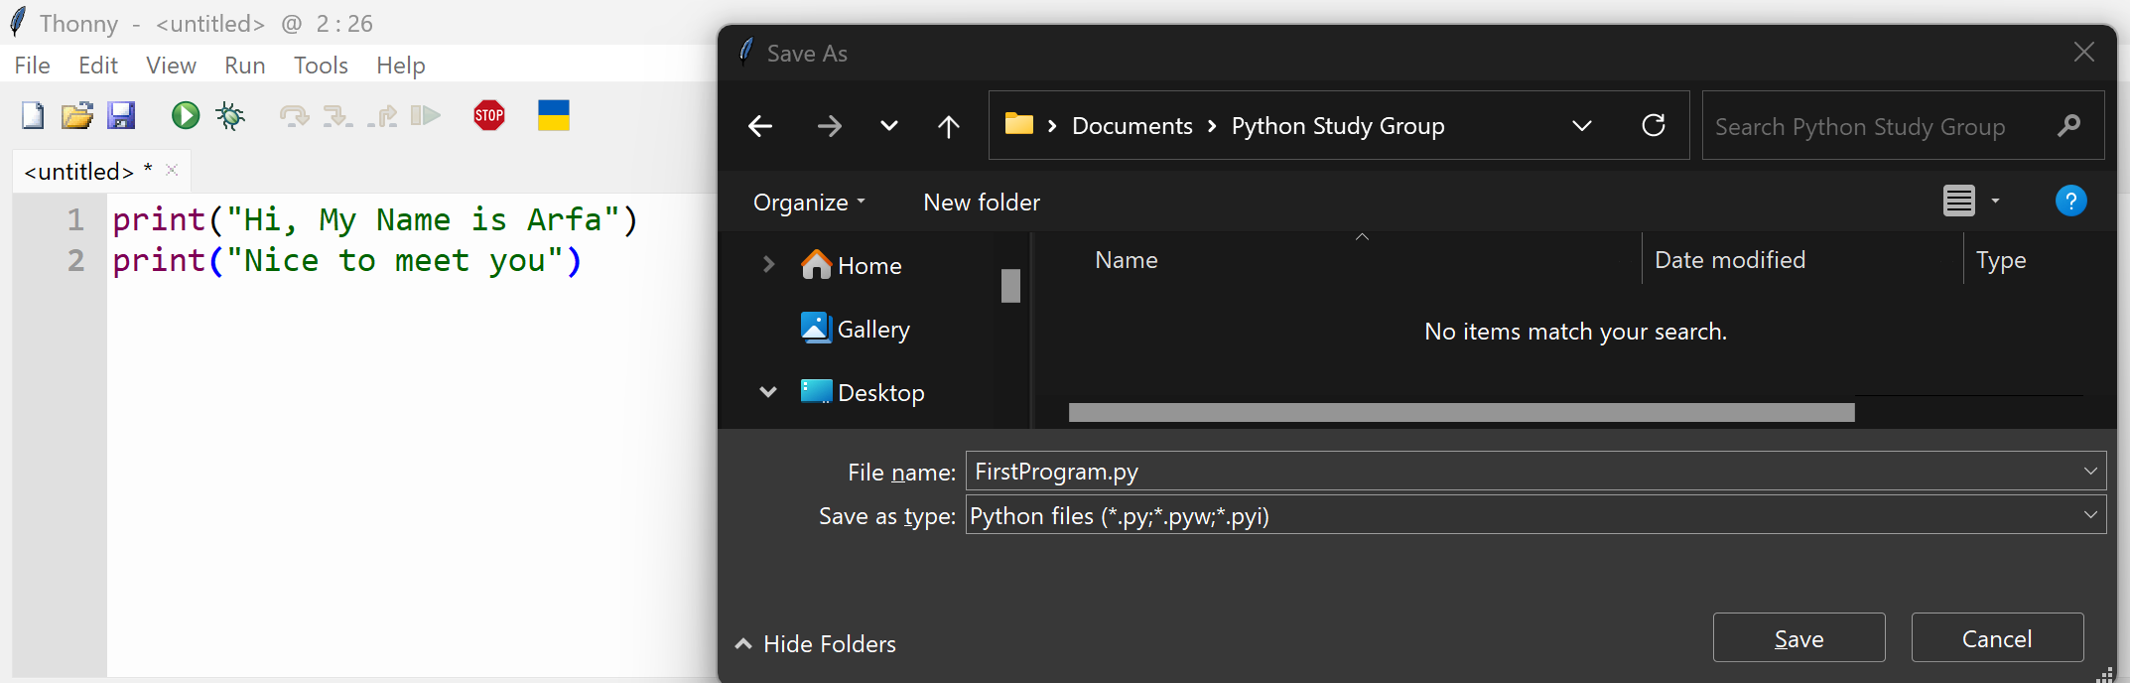

Slide 15
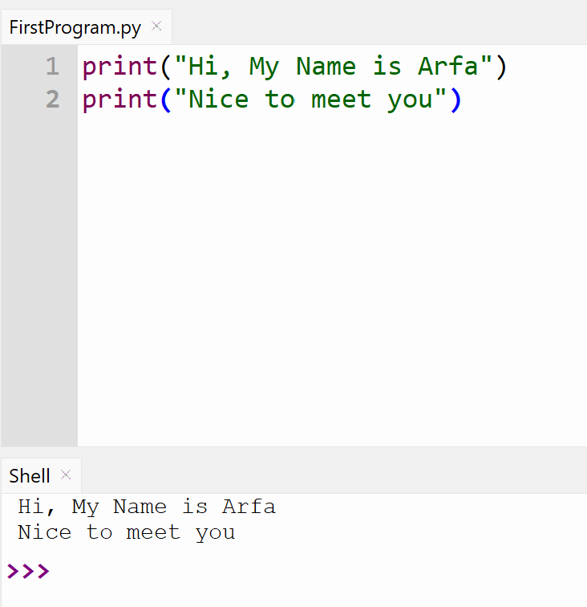

Slide 16
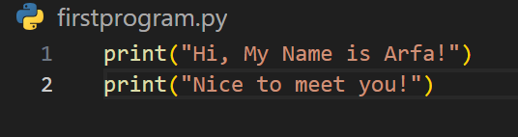
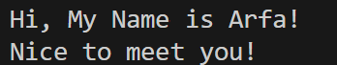
VSCode!
Output:

Slide 17
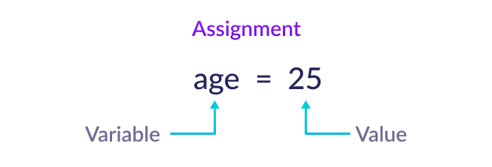
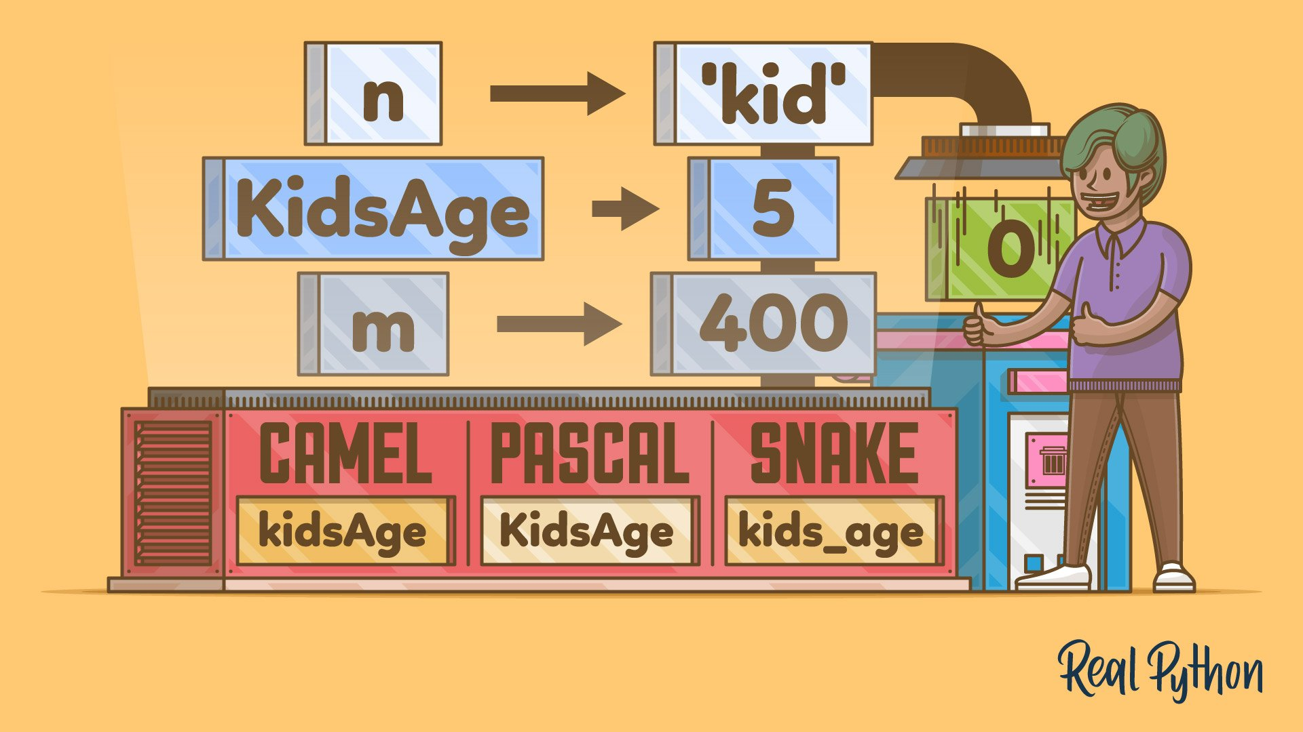
Variables in Python
What are Variables?
Variables are containers for storing data values.
Creating or Declaring a variable:
Syntax: VariableName = [value]
message = "Hello, World!"
age = 25
pi = 3.14
Naming Variables
Can contain letters, numbers, underscores (_).
Must start with a letter or underscore.
Case-sensitive (age vs. Age).

Slide 18
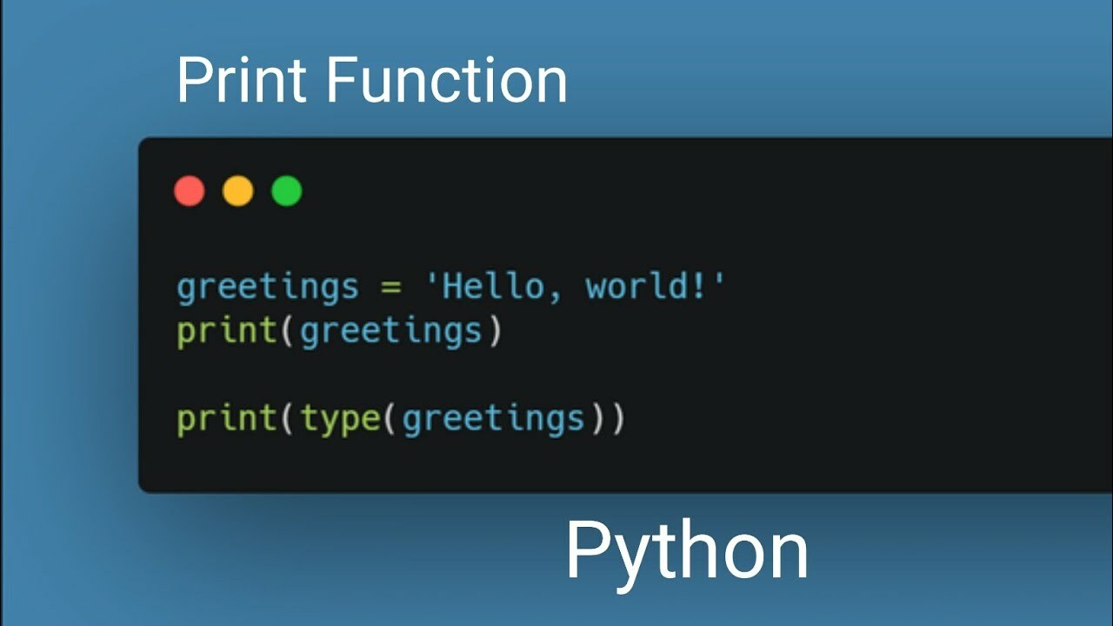
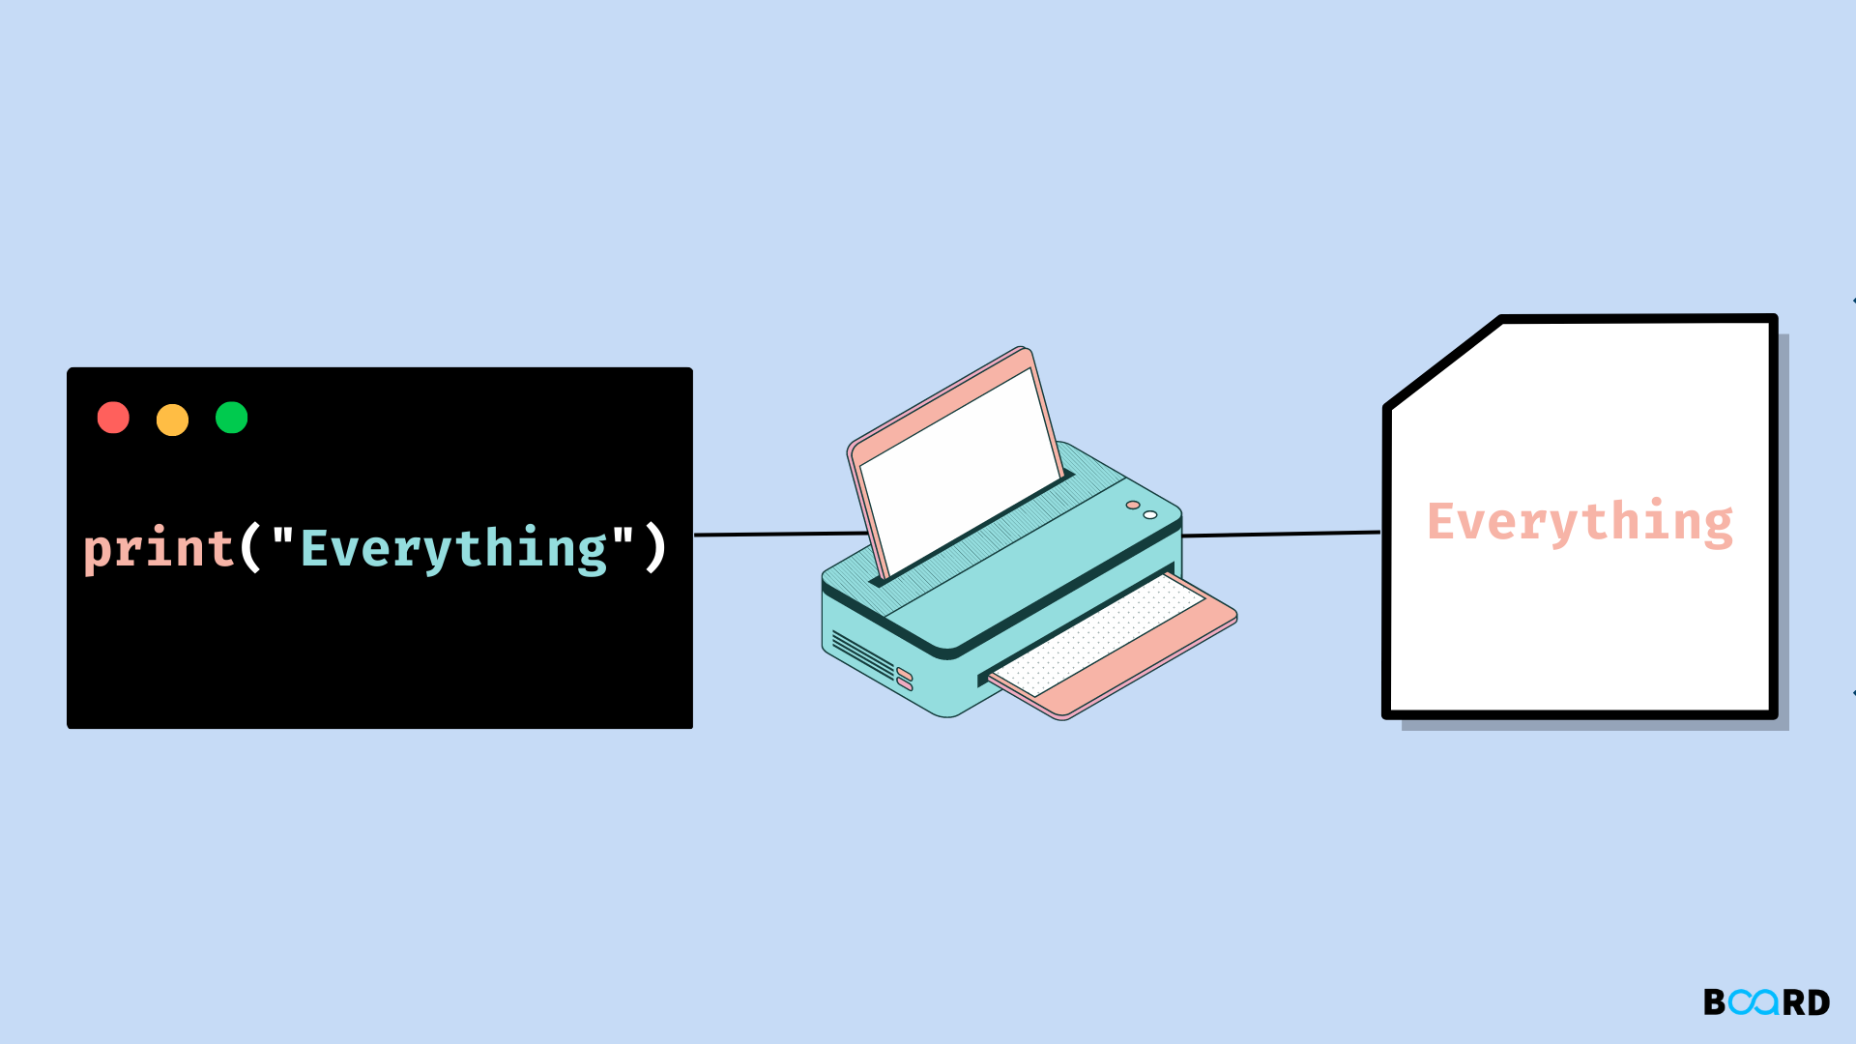
Print Keyword
The print function in Python is used to output text and other data to the console or terminal. It is one of the most basic and commonly used functions in Python.
Print syntax: print([objects])
Printing multiple values: print([object 1], [object 2],…[object n])

Slide 19
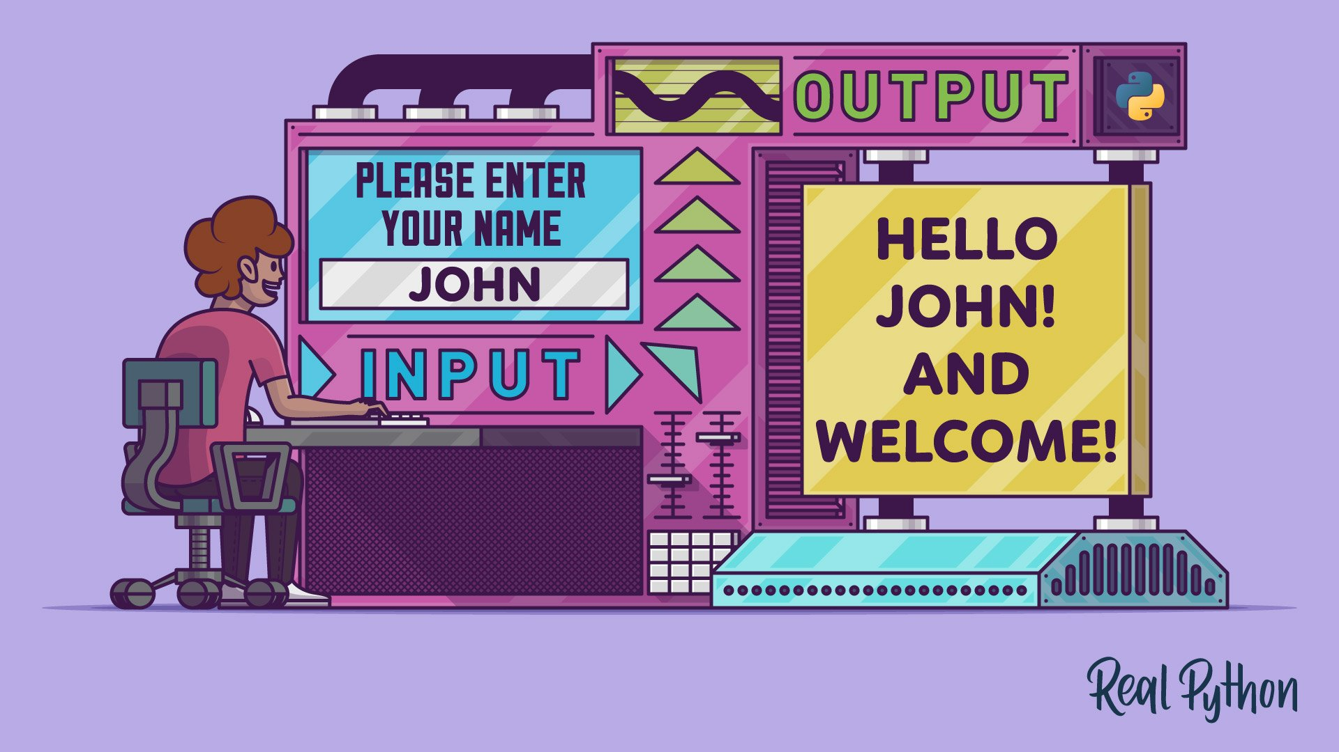
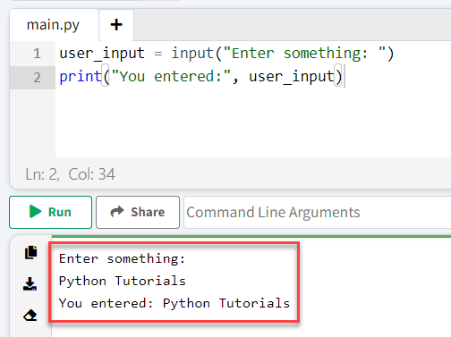
Getting user Input
What is the input() Function?
Lets you get information from the user.
The user input can be stored in a variable.
Syntax:
variable_name = input("Your prompt here: ")
Example:
age = input("How old are you? ")
print("You are " + age + " years old.")

Slide 20
Comments
What are Comments?
Notes in your code that Python ignores.
Help explain what your code does.
Use comments to make your code easier to understand!
Single-Line Comments | Multi-Line Comments
Start with # | Use triple quotes ''' or """
# This is a single-line comment | """ This is a multi-line comment. It can span multiple lines. """

Slide 21
Mini Test
https://docs.google.com/forms/d/e/1FAIpQLScqIRlqo_N-NLGaKcoGkKrQRlhtwDnStl-efndsUOc7pSdv1w/viewform?usp=sf_link

Slide 22
Additional Resources
Cisco Python Essentials 1 https://skillsforall.com/course/python-essentials-1?courseLang=en-US
https://realpython.com/
https://www.w3schools.com/python/
https://www.geeksforgeeks.org/python-programming-language-tutorial/

Slide 23
Preview of Next Week!!
Differentiate between the different data types.
Understand concepts like Dynamic Typing and Type Casting.
Use the different operators to perform operations.
Learn about Complex data Types such as Lists and Dictionaries.

Slide 24
